Slide 1
ITU Kaleidoscope 2015
Eric Viardot
11/12/2015

Slide 2
THE ROLE OF TRUST AND STANDARDIZATION IN THE ADOPTION OF INNOVATION

Slide 3
AGENDA
THE RELATIONSHIP BETWEEN TRUST, STANDARDIZATION IN THE ADOPTION OF INNOVATION
ADOPTION OF INNOVATION IS BECOMING A PRIORITY
A MARKET VIEW OF THE ADOPTION OF INNOVATION
THE ROLE OF TRUST IN THE ADOPTION PROCESS OF INNOVATION
STANDARDIZATION AND TRUST IN THE ADOPTION OF INNOVATION

Slide 4
AGENDA
THE RELATIONSHIP BETWEEN TRUST, STANDARDIZATION IN THE ADOPTION OF INNOVATION
ADOPTION OF INNOVATION IS BECOMING A PRIORITY
A MARKET VIEW OF THE ADOPTION OF INNOVATION
THE ROLE OF TRUST IN THE ADOPTION PROCESS OF INNOVATION
STANDARDIZATION AND TRUST IN THE ADOPTION OF INNOVATION

Slide 5
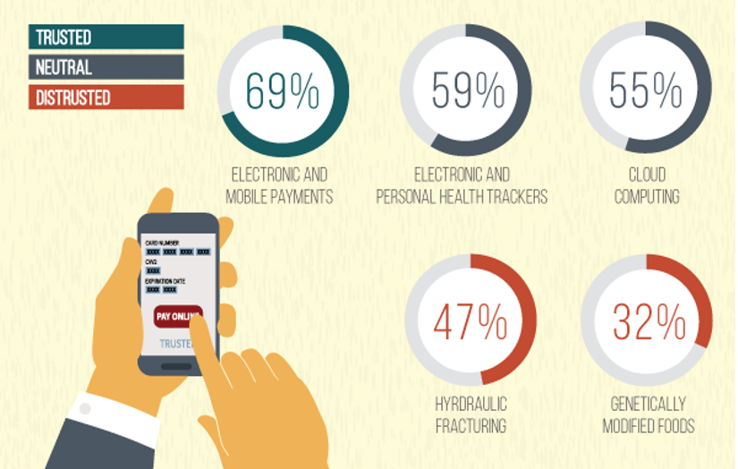
TRUST IS AN ESSENTIAL FACTOR TO DRIVE THE MARKET ACCEPTANCE OF AN INNOVATION
Source: Edelman (2015).Trust and innovation

Slide 6
THE RELATIONSHIP BETWEEN TRUST, STANDARDIZATION IN THE ADOPTION OF INNOVATION
Adoption of innovation
Trust
Standardization

Slide 7
AGENDA
THE RELATIONSHIP BETWEEN TRUST, STANDARDIZATION IN THE ADOPTION OF INNOVATION
ADOPTION OF INNOVATION IS BECOMING A PRIORITY
A MARKET VIEW OF THE ADOPTION OF INNOVATION
THE ROLE OF TRUST IN THE ADOPTION PROCESS OF INNOVATION
STANDARDIZATION AND TRUST IN THE ADOPTION OF INNOVATION

Slide 8
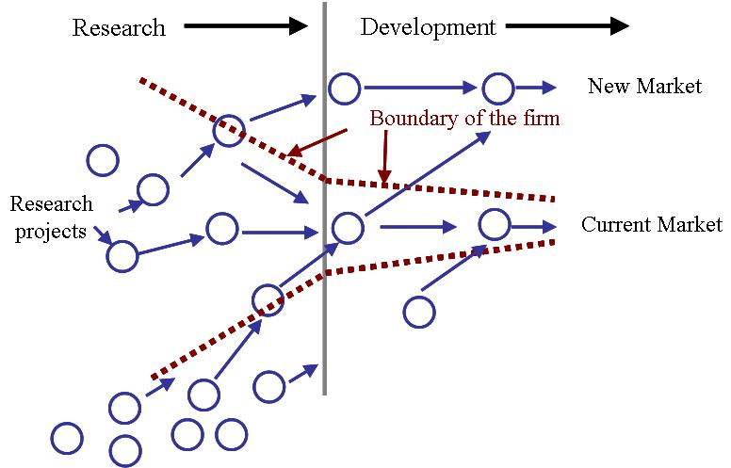
MOVING FROM THE UPSTREAM TO THE DOWNSTREAM OF THE INNOVATION MANAGEMENT PROCESS
Source: Chesbrough, H. W., & Garman, A. R. (2009)

Slide 9
AGENDA
THE RELATIONSHIP BETWEEN TRUST, STANDARDIZATION IN THE ADOPTION OF INNOVATION
ADOPTION OF INNOVATION IS BECOMING A PRIORITY
A MARKET VIEW OF THE ADOPTION OF INNOVATION
THE ROLE OF TRUST IN THE ADOPTION PROCESS OF INNOVATION
STANDARDIZATION AND TRUST IN THE ADOPTION OF INNOVATION

Slide 10
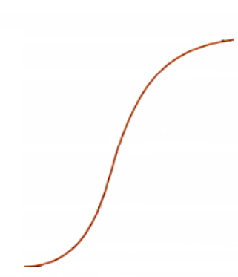
INNOVATION ADOPTERS
100%
Late Majority
of adopters
% of
cumulative
adopters
Early
Majority
of adopters
Early
Adopters
0%
Time
Social, functional, hedonic and/or cognitive reasons
. Measurable incremental benefit
. Price sensitive
.Risk averse.
. Follow the herd

Slide 11
AGENDA
THE RELATIONSHIP BETWEEN TRUST, STANDARDIZATION IN THE ADOPTION OF INNOVATION
ADOPTION OF INNOVATION IS BECOMING A PRIORITY
A MARKET VIEW OF THE ADOPTION OF INNOVATION
THE ROLE OF TRUST IN THE ADOPTION PROCESS OF INNOVATION
STANDARDIZATION AND TRUST IN THE ADOPTION OF INNOVATION

Slide 12
THE 3 DIMENSIONS OF TRUST
Customer’s belief that :
Credibility
Provider has the required expertise to perform the job effectively.
Trust
Integrity
Partner will stand by its words and fulfill given promises
Benevolence
Partner is motivated to act in the interest of the customer’s welfare

Slide 13
RISK AND TRUST
natural disasters
macroeconomic and financial crisis
political risks
security risks
universal risks
Internal risks : financial risks and operational risks associated with the product and the service and the possible risk of unanticipated requirement for additional resources
Transactional risks vis-à-vis an innovation provider due to a lack of expertise and a lack of motivation
individual risks.
confidence that provider is reliable and trustworthy
faith in the integrity, benevolence, and honesty of the associate

Slide 14
THE IMPACT OF THE COMPONENT OF TRUST ON THE ADOPTION DRIVERS DEFINED BY THE UTAUT MODEL
Performance Expectancy
Effort Expectancy
Behavioral Intention
Credibility
Social Influence
Use Behavior
Trust
Integrity
Facilitating Conditions
Benevolence

Slide 15
ADOPTERS HAVE DIFFERENT PRIORITIES
Early Adopters
Late Adopters
Benevolence
Credibility
Credibility
Benevolence
Integrity
Integrity

Slide 16
AGENDA
THE RELATIONSHIP BETWEEN TRUST, STANDARDIZATION IN THE ADOPTION OF INNOVATION
ADOPTION OF INNOVATION IS BECOMING A PRIORITY
A MARKET VIEW OF THE ADOPTION OF INNOVATION
THE ROLE OF TRUST IN THE ADOPTION PROCESS OF INNOVATION
STANDARDIZATION AND TRUST IN THE ADOPTION OF INNOVATION

Slide 17
STANDARDIZATION, INNOVATION AND TRUST
100%
Late Majority
of adopters
% of
cumulative
adopters
ANTICIPATORY STANDARDS
ENABLING STANDARDS
RESPONSIVE
STANDARDS
Early
Majority
of adopters
Early
Adopters
0%
Time
Time

Slide 18
STANDARDIZATION OF TRUST TO ENABLE THE ADOPTION OF INNOVATION
RISK MANAGEMENT STANDARDS
Australia (1995),
Canada,
United Kingdom,
Japan,
the United States,
ISO 31 000 (2009)
ITU
various analyses of risk management,
cybersecurity risk indicator,
risk analysis of next generation networks
....
Focus on the external risks and the potential technical
or operational failures from a provider’s point of view.
Risks related to the lack of motivation of suppliers?

Slide 19
RISKS RELATED TO THE LACK OF MOTIVATION OF SUPPLIERS
Type of criteria which have to be used and their measurement?
Cultural dimension of truth
Limits of SDOs

Slide 20
Thank you

